Slide 1
Sensation and Perception
Chapter 4

Slide 2
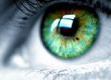
Sensation and Perception
Vision pretest
  2 basketballs
  Team members in white shirts
  How many times do the basketballs get passed around?

Slide 3
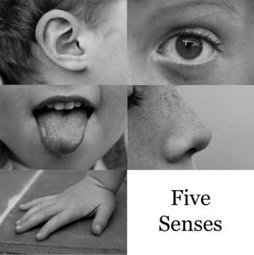
Sensation and Perception
Sensation
  Information arriving from the sense organs
Perception
  Brain organizes sensations into meaningful patterns
  Sensory coding
T or F: Sensory receptors respond best to changes in stimulation?
  Sensory adaptation

Slide 4
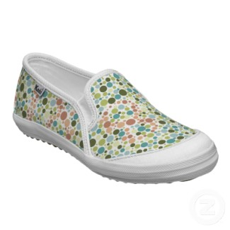
Sensation and Perception
What is the difference between color blindness and color weakness?
  Red-green color deficiencies
  Review the Ishihara color test with your neighbor (Figure 4.12, p. 133)

Slide 5
Sensation and Perception
Perception
  What is the difference between bottom-up and top-down processing?
  Illusion versus hallucination
    External stimuli
    Constant misjudgment
      Length
      Position
      Motion
      Curvature
      Direction
      Kevin James – Chainsaw illusion

Slide 6
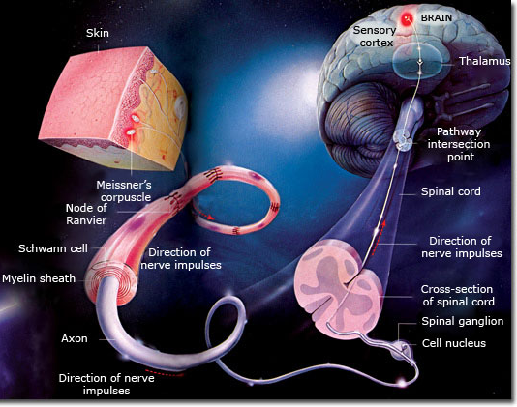
Sensation and Perception
Skin Sensations
  Touch
  Pressure
  Pain
  Warmth
  Cold

Slide 7
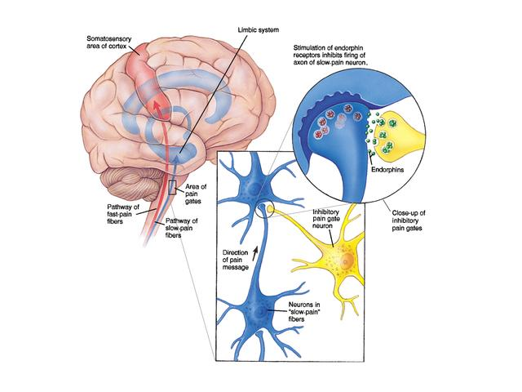
Gate control theory
  Transmission cells
  Inhibitory cells
  Serotonin
  Emotions
  Flexibility
Chronic pain disorders
  IBS
  CFS
  FMS

Slide 8
Sensation and Perception
Selective attention
  Inattentional blindness
    Narrow attention
    Distraction
    Cost trade off
    Storage failure
    Change blindness example (http://youtu.be/vBPG_OBgTWg)

